Slide 1
Distance challenge

Slide 2
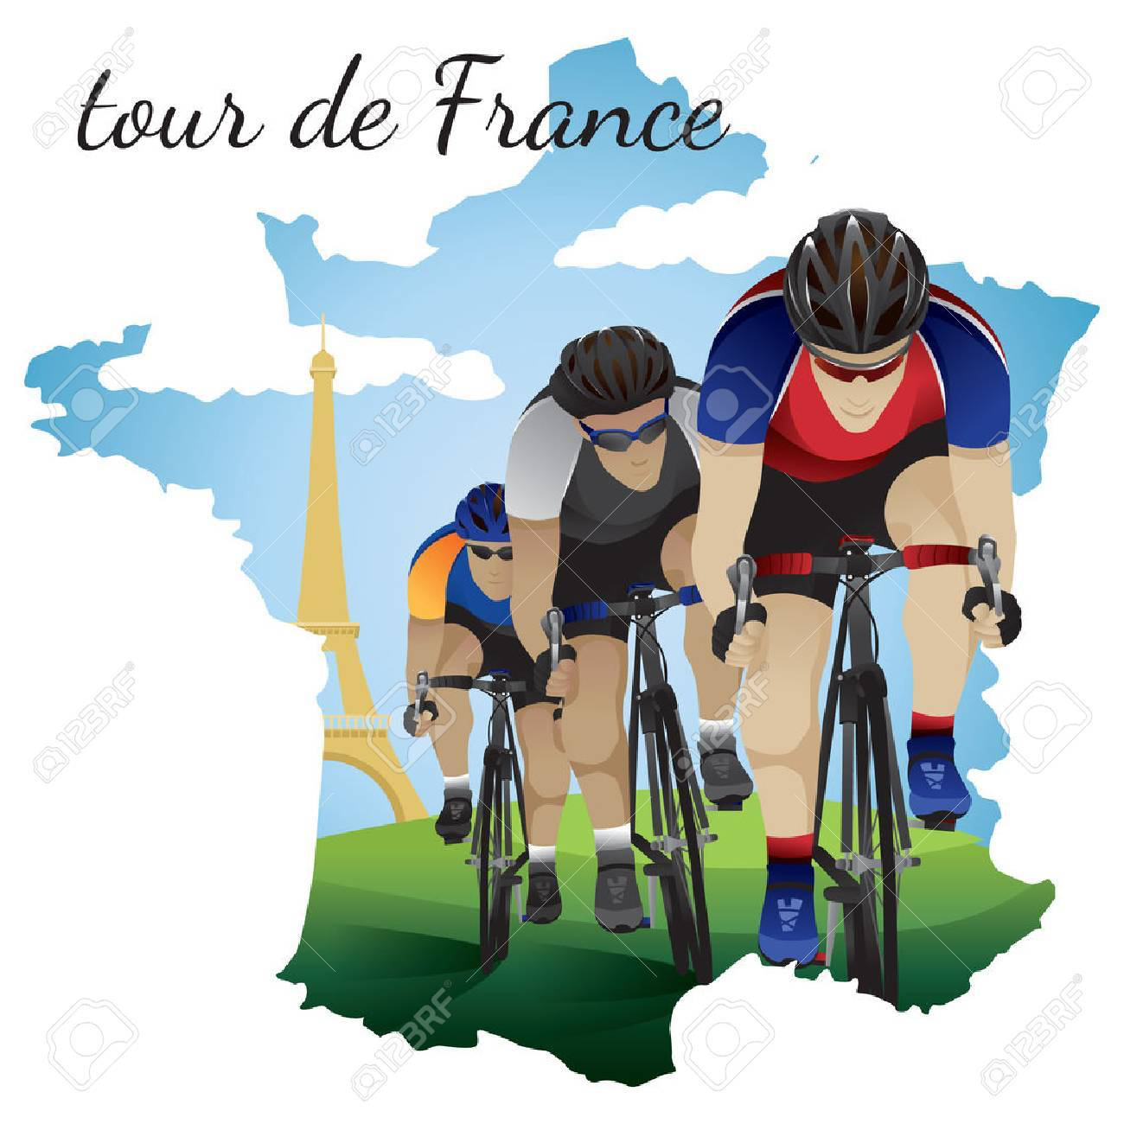
TOUR DE FRANCE CHALLENGE
Equipment
A timer (watch, clock IPAD etc.) with a second hand
A piece of paper and a pencil
Water bottle
Optional - Bike if safe and happy to ride
Challenge
Lying on your back on the floor with your legs up in the air
Ride your imaginary bicycle. Each time you complete one revolution (circle) with your feet counts as one.
Count the total number of revolutions/circles your feet make in 5 mins.
If you have a bike on a turbo trainer or can go outside to ride, you can count your revolutions riding instead.
Rest for 5 mins, drink some water, stretch, then ride your bicycle for another 5 mins.
Count up the total number of revolutions/circles you do during the lesson ( 3 lots of 5 mins).
At the end of the session, if you would like to enter a personal best, write your final score on your Showbie with the title “Tour de France Challenge.”
The Tour de France is 3,500km long! How quick can your legs work?!

Slide 3
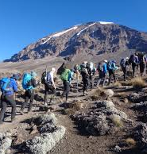
KILIMANJARO CHALLENGE
Equipment:
a timer (watch, clock IPAD etc.) with a second hand
piece of paper and a pencil
a flight of stairs (10 steps approx)
water bottle
Challenge:
Climb up and down a short flight of stairs (approx. 10 steps). How many times can you go up and down in 5 mins? Up and down equals 20 steps.
Write your total down. Rest for 5 mins, have some water and stretch then repeat twice (3x5mins.) Add your total to the previous one.
At the end of the session, if you would like to enter a personal best, write your final score on your Showbie with the title “Kilimanjaro Challenge.”
How close can you get to the top of Mount Kilimanjaro 128,263 steps?!

Slide 4
ROAD TO TOKYO 2021
Equipment:
a timer (watch, clock, IPAD etc)
piece of paper and a pencil
water bottle
Challenge:
Run on the spot or in a space, inside or outside, for 2 mins counting each step. Write down the number of steps you take
Rest for 5 mins, have a drink of water and a stretch then repeat again 2 more times (3 x 5mins in total.) Add the total steps to your previous total.
Keep a note of your score and then start from that number next time you do the challenge again.
Can you reach 5,000 steps (=5km) or even 55,000 steps (=marathon) by half term?
Toyko is 9562km away so approximately 9,562,000 steps!

Slide 5
Relay Challenge
Instructions
Choose a course to run / cycle / swim.
Select a time limit (eg 10 mins).
Each family member completes the course and recovers until everyone has done it.
Keep going for your allocated time and see what distance you can cover together.
Variations
Split into teams – parents v children!
Go again and see if you can beat your previous score.
Use different movements - hopping, two footed jumps, grapevine... (very short courses / shuttles!)

